Slide 1
<<time>>
Notes:
Use https://www.bitmoji.com/ to create an avatar.
Add Slides Timer extension to your browser: https://chrome.google.com/webstore/detail/slides-timer/nfhjdkmpebifdelclimjfaackjhiglpc?hl=en

Slide 2
<<time>>
Notes:
Your CM for Secondary students should emphasize specific struggles for this difficult age, and ways to solve them. Plan your CM accordingly.

Slide 3
<<time>>
Notes:
Don’t stick to the usual CM rules used for Primary (such as Be quiet!; Be nice!; Sit nicely!, etc.)
Create your Secondary CM rules based on both age and language abilities. You can even grade your CM rules so as to comprise grammar/language features, idioms, etc. Be inventive!

Slide 4
<<time>>
Notes:
Useful websites:
https://giphy.com/
https://www.bitmoji.com/
Slides Timer

Slide 5
<<time>>
Notes:
Keep your CM rules short and concise. 5 rules should be more than enough.

Slide 6
<<time>>
Notes:
Don’t forget to include at least 1 rule associated with students’ well-being. It’s vital for this group of age. Some other good examples of such rules would be: I am enough; I can do it; I approve of myself, etc.

Slide 7
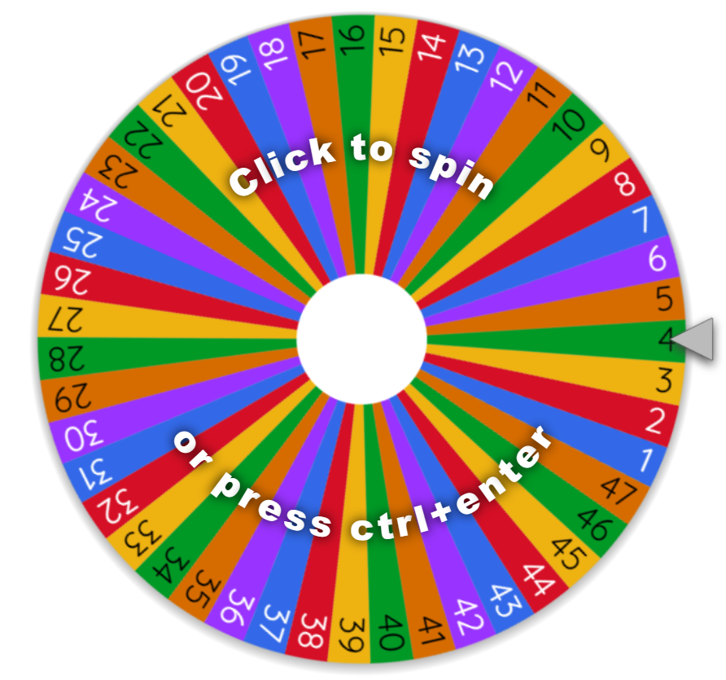
<<time>>
10.00
Notes:
Presentation slide.
As long as the heart stays at 10.00 there will be a spinning wheel at the end of the lesson. One student to win a treat (candy, sticker, pencil, snack, etc). On the wheel, there are numbers from 1 to 50, or as many students are in the class at the time.
Full folder CM>>>>

Slide 8
<<time>>
10.00
Notes:
Presentation slide.
As long as the heart stays at 10.00 there will be a spinning wheel at the end of the lesson. One student to win a treat (candy, sticker, pencil, snack, etc). On the wheel, there are numbers from 1 to 50, or as many students are in the class at the time.
Full folder CM>>>>

Slide 9
<<time>>
10.00
Notes:
Presentation slide.
As long as the heart stays at 10.00 there will be a spinning wheel at the end of the lesson. One student to win a treat (candy, sticker, pencil, snack, etc). On the wheel, there are numbers from 1 to 50, or as many students are in the class at the time.
Full folder CM>>>>

Slide 10
<<time>>
<<00:17->>
10.00
Notes:
Presentation slide.
As long as the heart stays at 10.00 there will be a spinning wheel at the end of the lesson. One student to win a treat (candy, sticker, pencil, snack, etc). On the wheel, there are numbers from 1 to 50, or as many students are in the class at the time.
Full folder CM>>>>

Slide 11
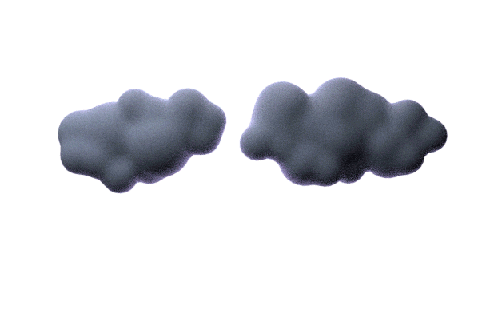
<<time>>
<<00:11->>
10.00
Notes:
Presentation slide.
As long as the heart stays at 10.00 there will be a spinning wheel at the end of the lesson. One student to win a treat (candy, sticker, pencil, snack, etc). On the wheel, there are numbers from 1 to 50, or as many students are in the class at the time.
Full folder CM>>>>

Slide 12
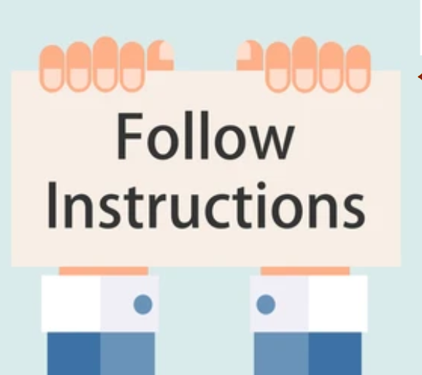
<<time>>
10.00
Follow
Class Rules
<<01:10->>
Notes:
Teacher shortly addressed the CM rules

Slide 13
Aggravating Circumstances
Critical
Urgent
Mitigating Circumstances
Warning
Teacher Assistant / Teacher Chat
Important
Refer to Class Rules
Notes:
Escalation plan - presentation slide

Slide 14
10.00

Slide 15
Important
Refer to Class Rules
Notes:
Escalation plan: Stage 1 - Important
When? At 9.00/8.50. At times when the class gets noisy or loses the focus.
Why? So as to remind the student(s) the CM rules and how important it is to follow them.
How? Refer to CM. Repeat CM rules. Do open/closed CCQs based on your rules, one at a time.
Example: Are you ready to learn? Do you think you doing your best now? What does respect mean to you?
Present the rules, again. Identify which rule has been broken. Raise awareness of what would happen in case of relapse, referring to the Escalation plan (presentation slide). Teachers are strongly encouraged to deliver CM through positive reinforcement, and not as a threat, nor punish. (2 min. maximum)

Slide 16
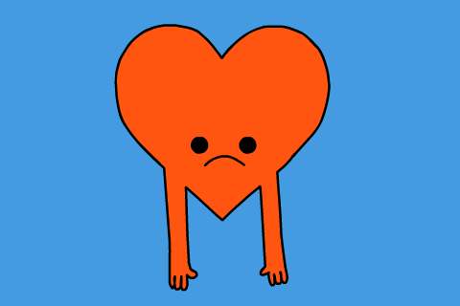
9.50
<<time>>
9.50
<<00:11->>
Notes:
The most important question here is when should a teacher go from 10.00 to 9.50. Where is the trigger? There are many situations where a teacher should be entitled to start this process.
It could be a second direct warning to a specific student (a finger pointed at them, or a simply ‘Mister!/Miss!’). A 9.50 means that something wrong has been repeated (a minor issue like a: small pair chat during teacher’s speech; a repeated uncontrolled laugh; premeditated minor incidents, etc)
Teachers are encouraged to mount back to 10.00 soon after the minor and repeated incident has stopped. Building on positive reinforcement will make the students aware of your CM. They will want the spinning wheel at the end of the class.

Slide 17
Warning
Teacher Assistant / Teacher Chat
Teacher Assistant’s private chat with the student;
Teacher’s chat with the class.
Notes:
Escalation plan: Stage 2 - Warning unlikely
When? At times when a student/ group of students disturb(s) the process of learning.
Why? To deal with the issue fast.
To save time.
To prevent a further escalation.
How? In a 10 seconds chat, (if necessary) instruct the TA on what to say to the student. This shouldn’t take more than a couple of minutes. Teachers should carry on with the lesson and let the TA solve the issue. TAs should call out the student (preferable somewhere outside the class) and talk to them privately.

Slide 18
9.50
<<time>>
9.00
<<00:11->>
Notes:
The most important question here is when should a teacher go from 10.00 to 9.50. Where is the trigger? There are many situations where a teacher should be entitled to start this process.
It could be a second direct warning to a specific student (a finger pointed at them, or a simply ‘Mister!/Miss!’). A 9.50 means that something wrong has been repeated (a minor issue like a: small pair chat during teacher’s speech; a repeated uncontrolled laugh; premeditated minor incidents, etc)
Teachers are encouraged to mount back to 10.00 soon after the minor and repeated incident has stopped. Building on positive reinforcement will make the students aware of your CM. They will want the spinning wheel at the end of the class.

Slide 19
Urgent
Mitigating Circumstances
Reminders/Complaints could be written in the register
Extensive chat with the student(s)
Notes:
Escalation plan: Stage 3 - Urgent (quite unlikely)
When? At times when the first two stages fail.
Why? Noisy classroom, problematic students. For repeated refusal to participate in lessons, or short/mild tantrums, etc. Minor Issues
How? Extended private chat TA-Student(s).

Slide 20
Aggravating Circumstances
Critical
Reminders/Complaints will be written in the register
Escalate the situation to STs/TLM
Notes:
Escalation plan: Stage 4 - Critical (very unlikely)
When? At times when the first three stages fail.
Why? Because serious insults were made, teachers, TAs feel/are being threatened. For fighting with other students, or
inappropriate sexual conduct such as touching or exposure, etc. See Major Issues.
How? Depending on the circumstances, teachers/TAs write a MEMO into the register/ inform TLM/STs.
It is very unlikely to reach this stage 4, though. The current display of this CM for Secondary prevent such an escalation. This has been tested on some of the most problematic secondary schools and worked perfectly. Good luck & keep up the good work.

